Slide 1

TENNESSEE SECRETARY OF STATE
TRE HARGETT
THE DIVISION OF RECORDS MANAGEMENT
PRESENTS
OPERATIONS
TRAINING

Slide 2

OVERVIEW
Determination of Format
Security and Privacy
Storing paper records in agency
Storing paper records offsite
Steps for transferring records to State Records Center (Richards & Richards)
Destroying Records
At the State Records Center
Confidential Records
Certificates of Destruction

Slide 3

RECORD FORMAT
Reformatting from paper to another medium is often viewed as a means of saving space and increasing access but it may not be the best or least expensive solution to a record-keeping problem.
Before implementing a reformatting plan, ensure files have been purged according to RDA’s and explore alternatives such as using a records center for storage.

Slide 4
ELECTRONIC STORAGE
Advantages:
Reduces need for physical space
Reduces wear and tear on originals
Facilitates indexing, searching, and retrieval
Allows for multiple access points
Recreates high-quality user copies with no image degradation
Disadvantages:
Requires software or hardware to access
Requires continuous monitoring and eventual or periodic migration and conversion
Faces software and hardware obsolescence
Necessitates time-consuming metadata creation
Requires expensive equipment to create and maintain
Standards are not universally accepted
Modification or corruption are potential authentication issues

Slide 5
STORING PAPER RECORDS
Advantages:
Does not require special technology aside from photocopier
Inexpensive
Disadvantages:
Increases need for physical space
Excessive deterioration of original
Results in image degradation

Slide 6
MAINTAINING RECORDS IN AGENCY
Advantages:
Quick access for business use
Easily available for audit, litigation, or record request purposes
Disadvantages:
Increases need for physical space
Expensive to store in agency by sq. ft.
Multiple copies and extra copies are often generated
Originals are handled often
Security risks if not properly stored

Slide 7
SECURITY
A secure facility should be locked, have controlled access for select personnel, and provide clear procedures for
storing, retrieving, utilizing, and re-filing records.
Nonpaper records, such as motion-picture film, audio, and microfilm, will require special storage considerations.
Permanent, historic, and/or essential records have special storage considerations.

Slide 8
ONSITE STORAGE
Records series that are referred to more than once per month are generally considered active and should be kept in the office, close to where they will be accessed.
Consider environmental and security concerns when looking for an appropriate storage site within your facility.
Ideal environmental conditions are consistent, with minimum fluctuation in temperature and humidity, and include areas that are:
Temperature maintained in the 65–70° range
Humidity maintained at 40% +/- 5%
Protected from fire by the installation of smoke detectors, water sprinklers, and fire extinguishers
Free of vermin and insects
Far from water pipes
Not in a flood zone or other natural disaster area

Slide 9
SELECTING RECORDS FOR OFFSITE STORAGE
Records that have not yet reached the end of their retention period but are rarely referenced are ideal candidates for storage in the SRC.
Transferring records to the SRC frees up space in an office for more useful purposes.
Often it is more economical to pay for off-site storage then to buy more file cabinets and pay for larger office space.
Ownership of the records is maintained by the agency/locality while records are housed in the SRC.

Slide 10
PREPARING RECORDS FOR TRANSFER:
1. Identify the appropriate Records Disposition Authorization
Records must be listed on an approved RDA,
with a finite disposal date, to be eligible for transfer and storage in the SRC.
Records of varying retention MAY NOT be stored together

Slide 11
PREPARING RECORDS FOR TRANSFER:
2. Determine the Volume of Records
To make sure the correct number of boxes is on hand and to prepare for
packing, estimate the cubic footage to be transferred.
To estimate cubic footage approximate how many files will fit into a cubic-foot box (15” x 13” x 10.5).
If there are more than 500 boxes contact Alice Drummond with Records Management Division to order a box report.

Slide 12
PREPARING RECORDS FOR TRANSFER:
3. Order Boxes
Only containers meeting certain specifications may be used in the SRC.
The standard size of these boxes can hold 14 inches of letter-size files or 11 inches of legal-size files.
Be uniform in size, ideally 15” x 13” x 10.5”.
Have double walls/bottoms so they can be safely stacked and reused.
Boxes made of acid-free cardboard are recommended if storing permanent/long-term records or if records will eventually be transferred to the Tennessee State Library and Archives.
Standard storage boxes, which are less expensive, can be used for nonpermanent records storage.

Slide 13
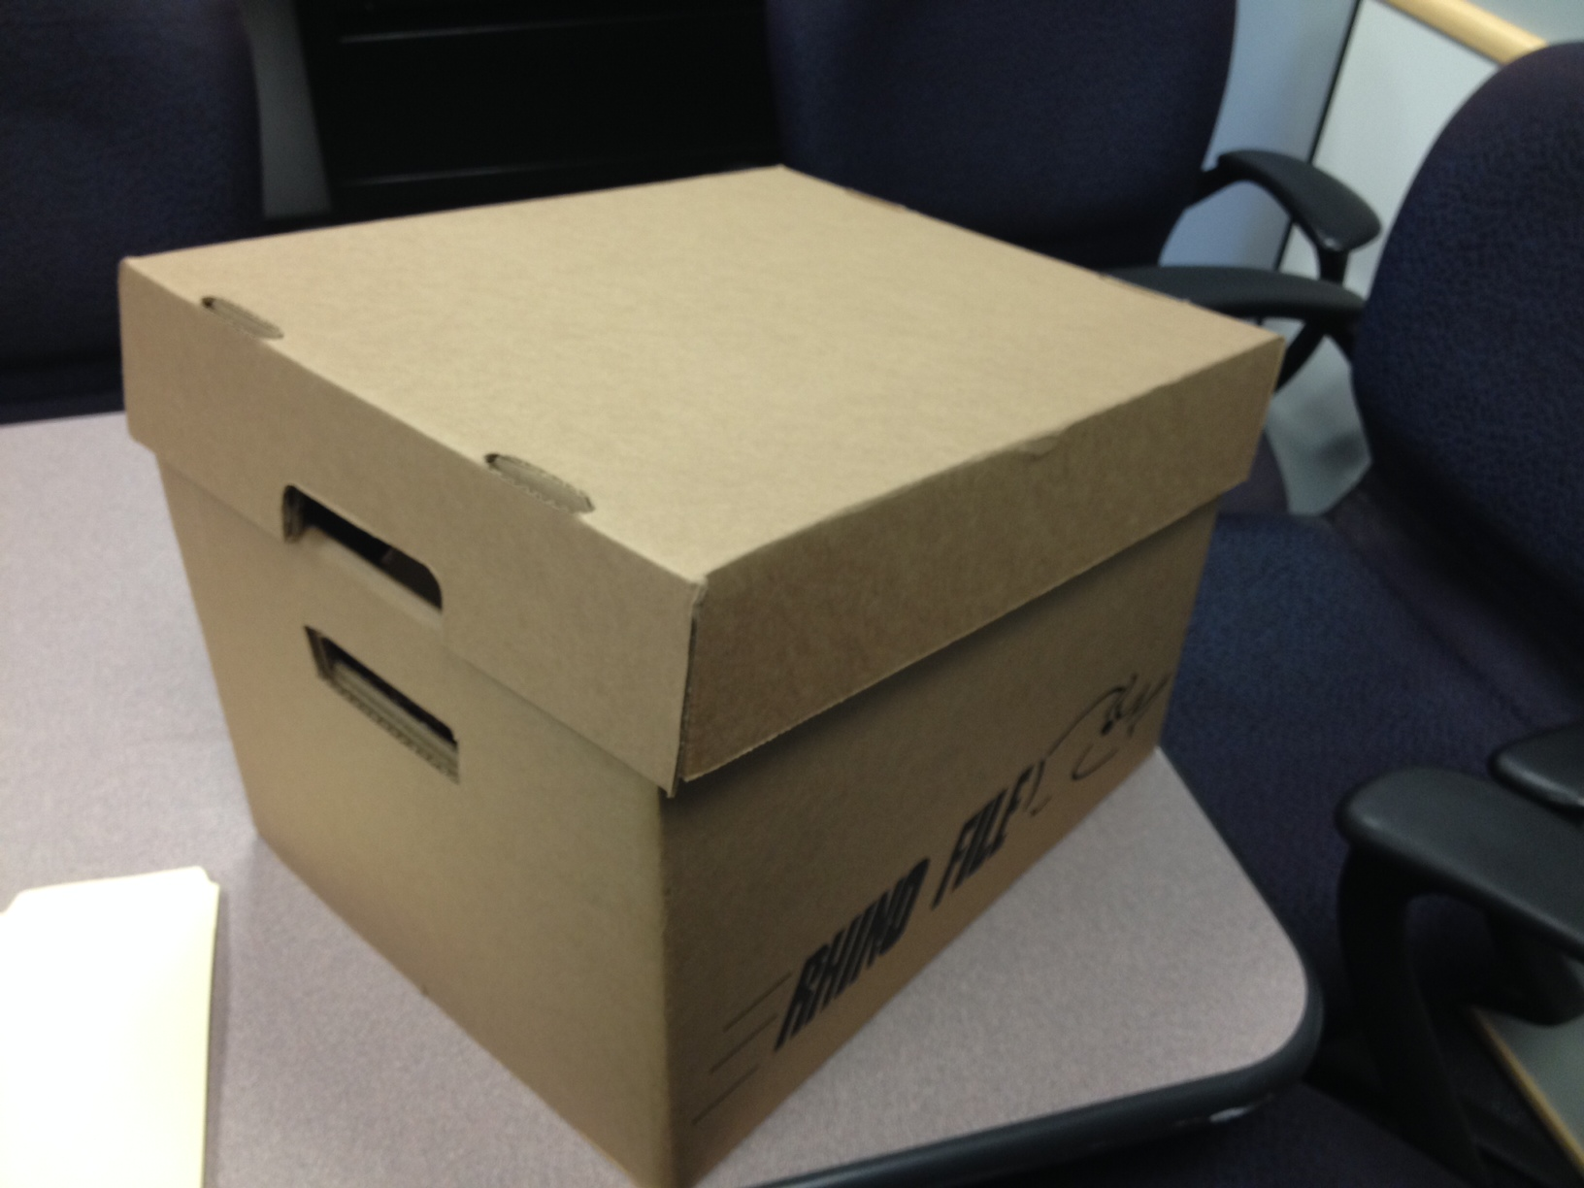

Slide 14
PREPARING RECORDS FOR TRANSFER:
4. Pack the Boxes
Carefully pack boxes so that files and materials can be easily removed and replaced, leaving about one inch of free space.
Materials must fit in the box without causing it to bulge and lids must fit correctly.
Materials should not be placed in hanging file folders within the box
Do not send damaged boxes, such as those that are crushed or have ripped handles.
Boxes should weigh about 30 pounds or less.
Files should be placed in the box in neat, logical order, as if they were in a file drawer.
File names or numbers must be visible.
Document the files placed in each box and keep a copy for reference.

Slide 15
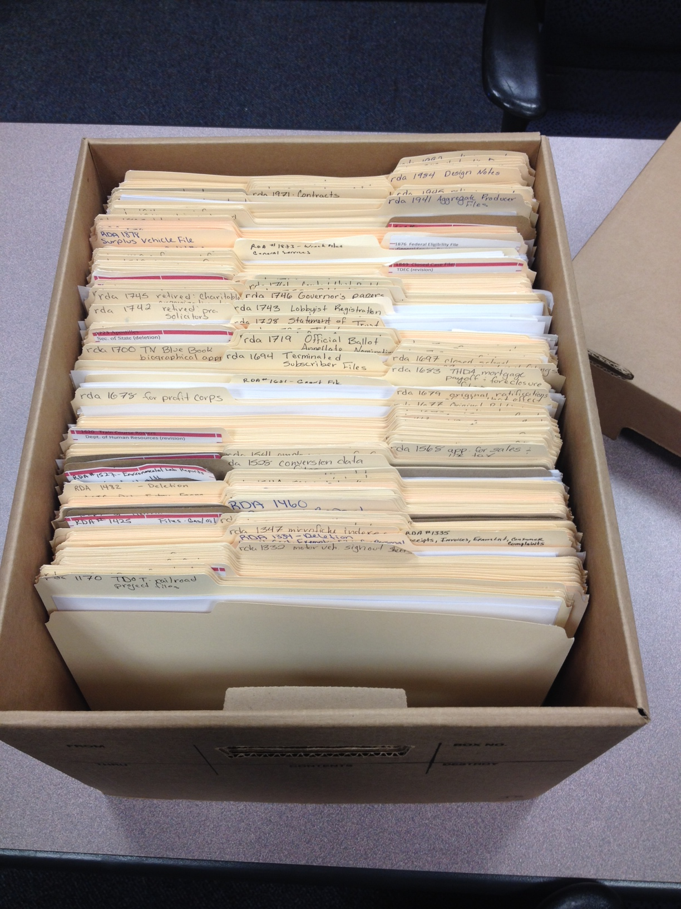

Slide 16
PREPARING RECORDS FOR TRANSFER:
5. Enter Boxes into Richards & Richards System
http://www.richardsandrichards.com/
R & R system instructions
To look up RDA#
Go to R & R website
RRWEB- right hand at top
Put in your user name and login
Go to inventory
Getting started
Quick search
Container
Go to arrow up top and click on RDA#
Put in RDA number
Hit the search button

Slide 17
PREPARING RECORDS FOR TRANSFER:
6. Label and Barcode Boxes
Apply the bar code labels to a handle side of the box,
in the bottom right hand corner approximately one inch from
the bottom and one inch from the left side.
To request Barcode labels, send a e-mail with to Alice Drummond with the following information:
allotment code
building name
floor
telephone number
number of barcodes needed

Slide 18
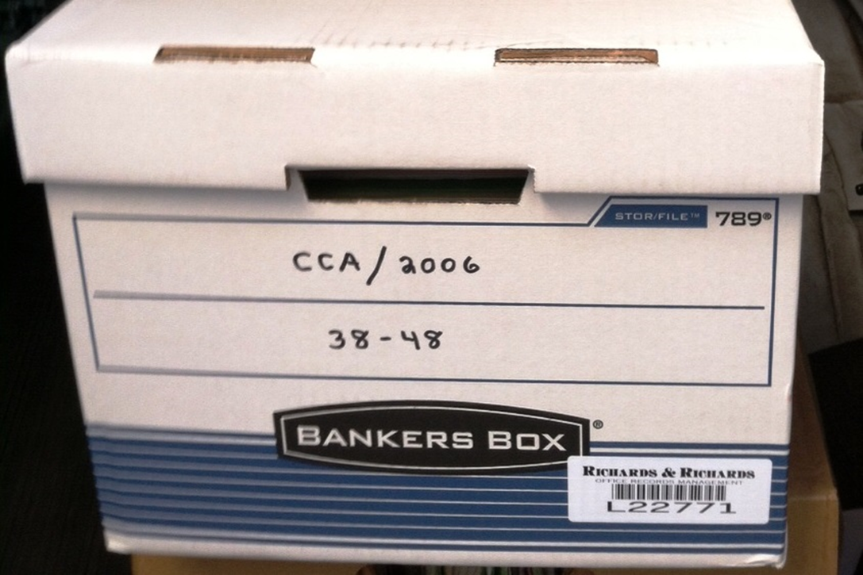
PREPARING RECORDS FOR TRANSFER:
6. Label and Barcode Boxes

Slide 19
PREPARING RECORDS FOR TRANSFER:
7. Arrange for Pickup
Notify Records Management staff that boxes are ready for transfer.
Assemble boxes in a location that is easily accessible for Records Management staff to pickup
Keep area clear to avoid a fire or trip hazard

Slide 20
REVIEWING BOXES AT RICHARDS & RICHARDS
Agency personnel may visit Richards & Richards to view records with the following considerations:
Richards & Richards must be notified ahead of visit
Visitors must present two forms of identification
The visit must be approved by the Records Officer

Slide 21
RETRIEVAL
Boxes may be retrieved from the State Records Center – usually by the next business day
For an emergency request contact Alice Drummond with the Batch#
Please note: if records are to be permanently removed, notify Records Management. Failure to do so may result in being charged for boxes that are no longer stored.
Contact Records Management when ready to return records to the facility. Records will be picked up and promptly returned to the
appropriate place.

Slide 22
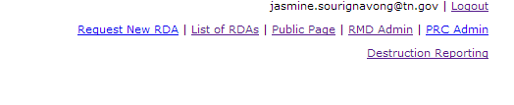
DESTRUCTION: using the web application
This new application will pull data from the Richards and Richards (R&R) site and create a report for agency Records Officers.
The agency has sixty days to respond to each prompt.
RMD is able to review the report and then submit it to R&R.
The report automatically generates the work orders for R&R thereby reducing multiple data entry steps and potential for error.

Slide 23
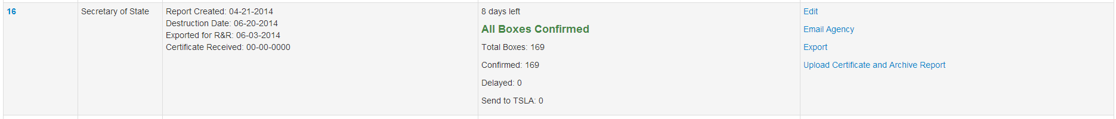
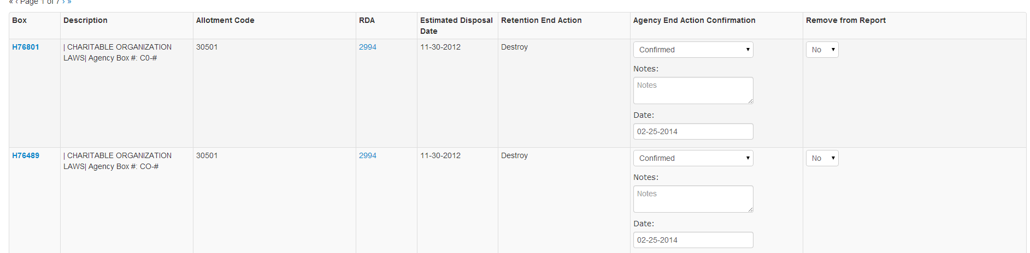

Slide 24
DESTRUCTION
The method of destruction depends on criteria described in the Records Disposition Authorization.
Those that are deemed confidential, private, or sensitive will be shredded for a fee by Richards & Richards to ensure that the information is protected.
Records not requiring confidential destruction may be recycled.
Any records may be confidentially destroyed on request.
Confidential records destruction services are also available for offices not using the Richards & Richards storage services.

Slide 25
DESTRUCTION: Certificates
The agency Records Officer is expected to review their agency’s records and determine which ones are due for destruction.
When records are destroyed in agency, a Certificate of Records Destruction form must be filled out and submitted to Records Management.
This form documents the destruction date, record series, RDA number, date range for the records, volume destroyed, and destruction method.
Records Management maintains all of the CRD’s and uses this information to monitor the record destruction process to ensure compliance with RDA requirements and statewide policies.

Slide 26
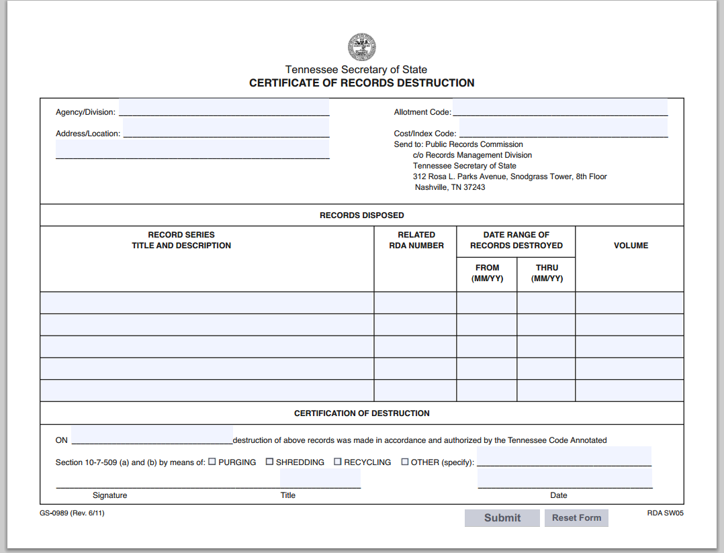

Slide 27
CONTACT INFORMATION: Operations Staff
Alice Drummond
Alice.Drummond@tn.gov
615-532-3384
Glen Cox
615-714-6299
Theron Lacy
Theron.Lacy@tn.gov
615-767-4847

