Slide 1
RDA Development
Jasmine Sourignavong, Records Management Division
TRE hargett, Secretary of State,

Slide 2
Records Disposition Authorizations
Records schedules are implemented through the establishment of Records Disposition Authorizations (RDA) which provide the following information:
Description of records grouped by common function or record series.
The length of time the records series must be kept.
Any legal restriction of access.
The required method of destruction.

Slide 3
Statewide RDA
Before creating a new rda, it is important to make sure the record is not already covered under a Statewide RDA
Statewide RDA’s Document records that state agencies have in common, such as fiscal, administrative, personnel, etc.

Slide 4
Specific RDA
Before Creating a new RDA, it is important to make sure the record does not already have an RDA.
This applies to records that are unique to a state agency’s operations and mission. The schedules identify records that the agency produces, collects, receives, or retains in carrying out its special functions.
Examples
  Surveys
  Grants
  Case Files
  Audits

Slide 5
Retention Schedule
Establishing a retention schedule requires appraising the use and value of information, as well as researching regulations that may govern retention
Retention schedules are not merely suggestions. Records cannot be destroyed before the stated period, nor should they be retained longer than the stated period unless they are involved in :
An investigation
Litigation
Audit
Request for records pursuant to the Freedom of Information Act

Slide 6
Benefits of a Retention Schedule
Benefits of a Retention Schedule
Ensures that an agency or department is in compliance with both state and federal laws.
Verifies that records with legal, fiscal, or administrative purposes are not destroyed prematurely.
Determines when records may be transferred to State Records Center or other location for permanent storage.
Details essential records protection plan.
Ensures the preservation of historical records
Indicates the privacy status of a records series.
Reduces cost by:
  Allowing records that are no longer useful to be legally destroyed.
  Reduce the space and equipment necessary for filing records in paper or electronic format.

Slide 7
Web App
Before you start creating, revising, or deleting an RDA:
Contact Your Records Officer
Obtain a log in and password
Visit http://www.tnsos.net/rmd/rda and log in to the site and click Request new RDA

Slide 8
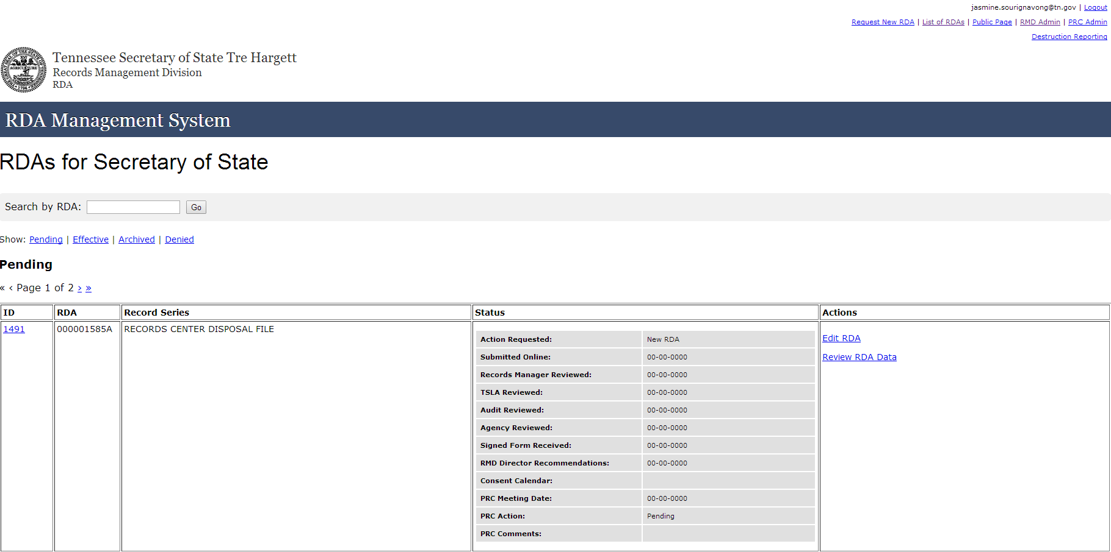

Slide 9
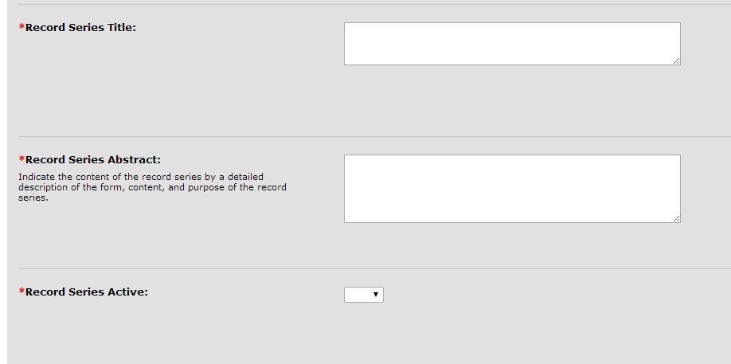
Core Data
Record Series Title
Determine a unique, specific, descriptive title for the record series. Titles should clearly identify the subject and/or functions of the records. Please spell out any acronyms.
Records Series Abstract
Describe the purpose of the records series, indicating:
  What documents are included in the records series.
  Any specific details that may be helpful such as form number.
Records Series Active
Indicate whether the records series is still in use- in other words, whether more files of this type are being generated.

Slide 10
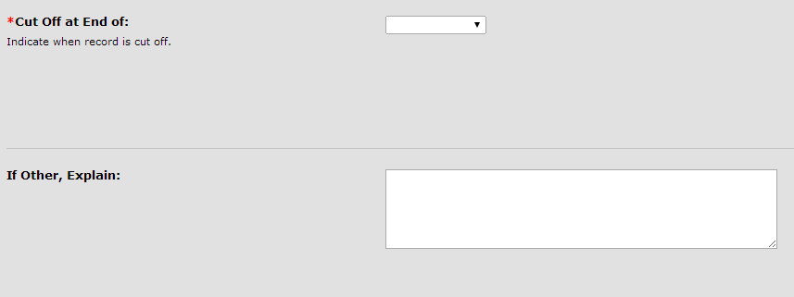
File Cutoff
File Cutoff
The file cutoff date is a break or stop in the filing of a current records series, based on a predetermined event. In a Record series that is active, this is when a new file is created for the records of the same type. The file cutoff date keeps related documents together.
The Web Application provides the two most common choices:
  Fiscal Year
  Calendar Year
Select other and provide and explanation if
  Files follow a different timeframe, such as:
    Federal Fiscal year
    Academic year
    The close of a case
    The end of a grant or program

Slide 11
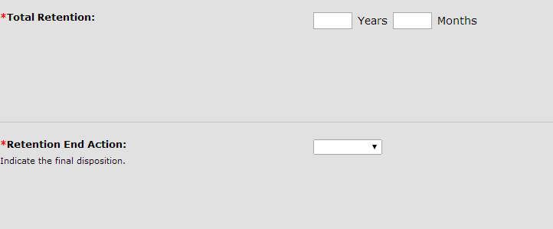
Retention
Total Retention
The total amount of time your agency is responsible for the retaining the record series- from file cutoff to final disposition. This includes any time the records may be held at the State Records Center.
For example: Records that are kept in agency for 10 years and then transferred to Richards and Richards for 10 years would equal 20 years total retention.
Retention End Action
Options: “permanent” or “destroy.” Records that are transferred to TSLA are classified as Permanent records

Slide 12
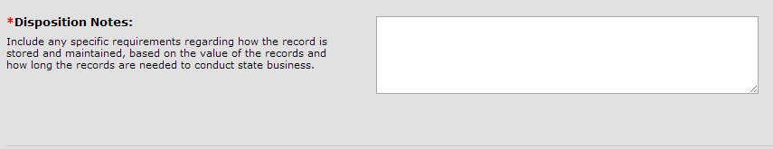
Disposition Notes
Disposition notes:
Provide a description of the life of the particular records series. Include the following:
  Explain how the record is received or generated.
  Identify the event that triggers the retention countdown.
  Describe any reformatting (paper, electronic, etc.)
  Detail where the record is stored and if/when it is transferred
  State the retention
  Describe the final disposition of the record series
  Describe any work processes that make the requested retention necessary.
For Example: Files are cut off when the employee terminates, maintained for ten years. Records may be maintained in either paper or electronic format, as long as the electronic content has been verified for completeness, accuracy, and usability. Records in Paper format may be transferred to the State Records Center. Records in electronic format shall be maintained in Office of Information Resources (OIR) approved software and server environment. Any sensitive or confidential information contained therein shall be destroyed according to standards for destruction of confidential information.

Slide 13
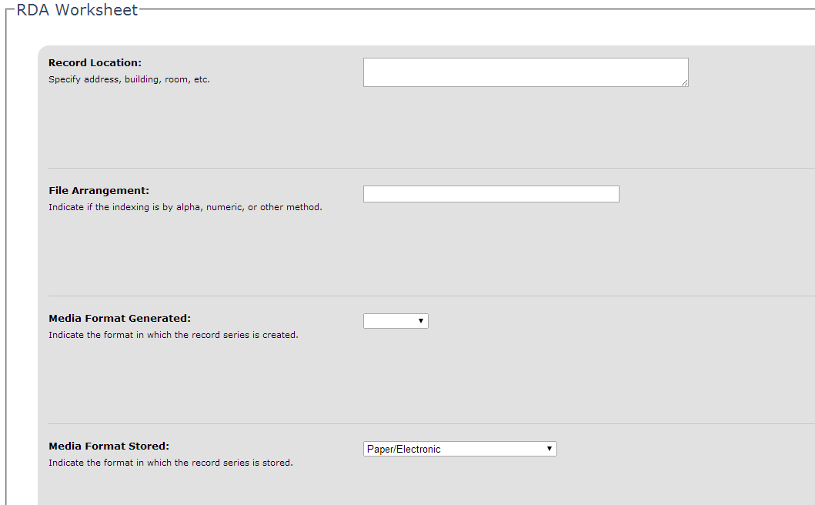
Worksheet
The Worksheet portion of the RDA describes how files will be arranged, categorized, accessed, and stored, whether in paper or electronic format. This information reflects good filing practices and ensures the right file can be retrieved quickly for the lowest possible cost.

Slide 14
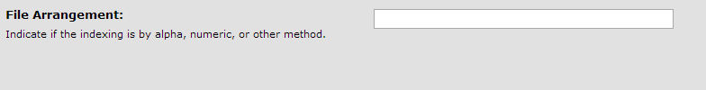
File Arrangement
Describes how files are organized. The most common methods of arranging documents are alphabetical, numerical, chronological, or alphanumeric. Sometimes it will be arranged by case number or grant number.

Slide 15
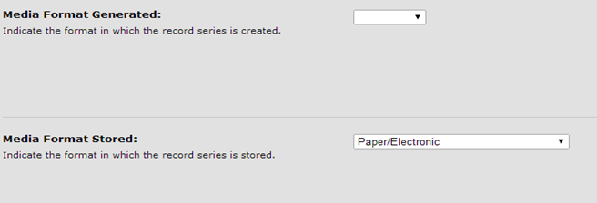
Media Format Generated and Media Format Stored
A particular record series may include multiple formats such as paper, electronic, or microfilm. This information is useful for TSLA in their appraisal of the records’ value. Provide information about the record format in all stages of its life: how it is received, stored, and if applicable, archived.

Slide 16
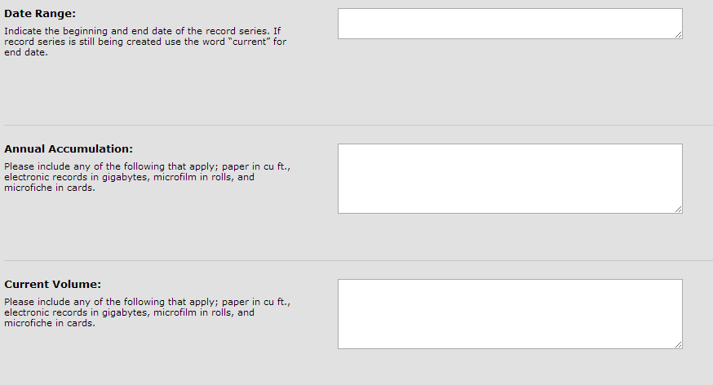
Date Range, Annual Accumulation, Current Volume
Date Range
Provide the range of years of accumulated records covered by this RDA.
Annual Accumulation
Provide an estimate of the volume of records created, received, and retained in the course of a year for the series in questions.
Current Volume
Provide an estimate of the total volume of records covered by this RDA, from the earliest to the most recent, in all storage location.

Slide 17
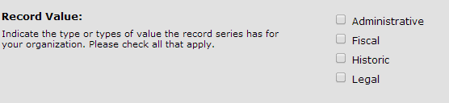
Record Value
Historical Value: Only a small percentage of records have permanent value, but these records are especially important since they document our state’s history; contains important information about persons, places, or events; or are valuable because of age or rarity. The Tennessee State Library and Archives determines the Historical Value of records desired for permanent retention.
For example; A lease signed by Andrew Jackson, Historical and Architectural Records.

Slide 18
Administrative Value
Administrative Value: These records are necessary for day-to-day operations, to conduct current or future business transactions, or to document the establishment of policy or programs.
Some examples include correspondence, studies, and reports.

Slide 19
Legal Value
Legal Value: These records have a mandated retention by statute or regulation. The Division of Records Management request assistance from the Office of General Counsel in order to determine the legal value of records.
Examples of these documents include leases deeds, student records, medical records, and court case files.

Slide 20
Fiscal Value
Fiscal Value: These Records document the fiscal responsibilities and transactions of an agency or department, such as receipt, payment, transfer, adjustment, or encumbrance of public funds. Most financial records usually lose value once an audit has been completed. However, certain records series may be governed by regulations beyond audit, such as federal regulations or contract language.
Examples include, cancelled checks, deposit slips, invoices, receipts, and purchase orders.

Slide 21
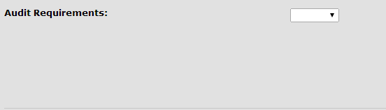
Audit Requirements
Audit Requirements
In order to ensure an effective government for the citizens of Tennessee, all records are subject to audit by the Comptroller’s Office
Please indicate whether or not the records series is subject to Federal Audit and use the space provided to list the interested agencies.

Slide 22
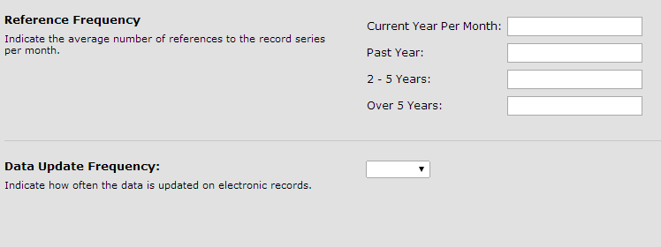
Reference Frequency and Data Update Frequency
Reference Frequency
  Indicate the average number of references to the record series per month.
Data Update Frequency
  Indicate how often the data is updated applies to electronic records only.

Slide 23
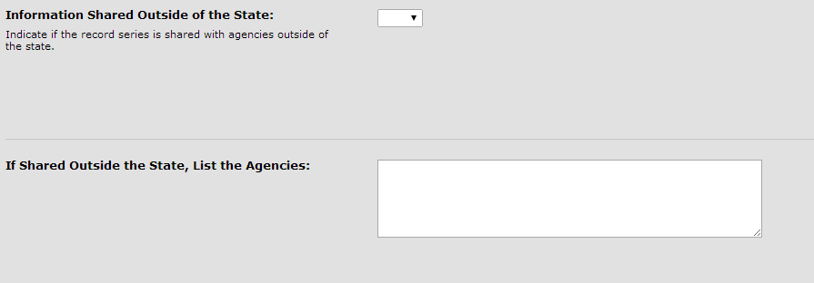
Information Shared Outside of the State
Indicate if the record series is shared with federal agencies or agencies of other states. If “yes” please list the agencies.

Slide 24
Essential Record
Essential records contain information required by an agency to function or to reestablish operations immediately in the event of a disaster. Without these records, public interest could be adversely affected by unplanned expenditures, lost revenue, lost information and efficiency, and disruption of operation. While some records have historical value, they may not be administratively necessary to keep an agency running or to provide to citizens.
The main protection methods for essential records are duplication and off-site storage. Duplication entails photocopying, scanning, or microfilming. It is strongly recommended that duplicates be stored offsite while still being accessible in the event of a disaster.

Slide 25
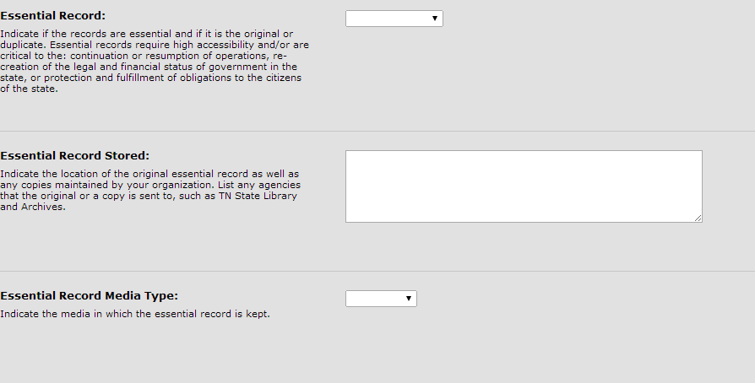

Slide 26
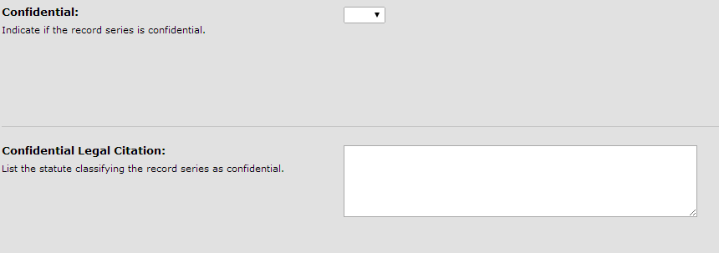
Confidentiality
Indicate whether any state or federal regulations restrict access to the records
Records that are deemed confidential must be covered by statute and a copy of the statute must be attached

Slide 27
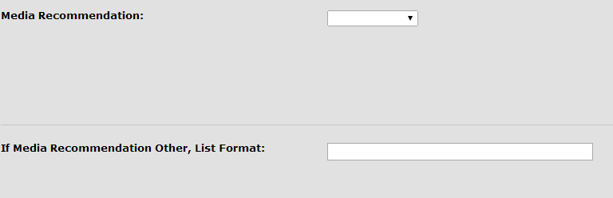
Media Recommendation
Media Recommendation
  This is the agency’s preferred/recommended format in which the records are/will be kept:
    Current Format (most common)
    Microfilm
    Microfiche
    Other

Slide 28
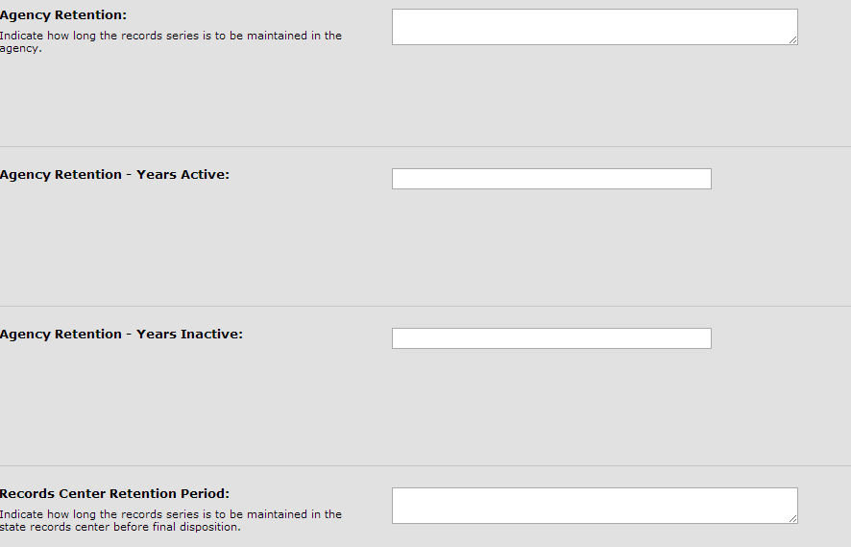
Retention
Agency Retention is the total time the records are kept in agency.
Agency Retention –Active and Inactive should equal the Agency Retention.
Records Center Retention Period is the total time records are kept at the records center.
Agency Retention and the Records Center Retention should equal the Total Retention located in the core data
For Example: If records are kept in agency for 1o years and then sent over to Richards and Richards for 20 years the total retention is 30 years.

Slide 29

Final Disposition
  Indicate action that is to occur after retention period expires. If it is not to be destroyed, it will either be transferred to State Library and Archives, Microfilmed, or Migrate to Electronic Data (if records are kept in agency permanently.)

Slide 30
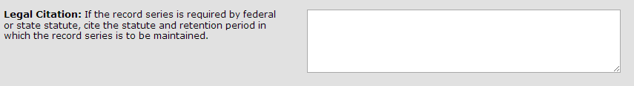
Legal Citation
  Indicate if the record series is covered by statute or rule:
    Tennessee Code Annotated (TCA)
    Code of Federal Regulations (CFR)
    Environmental Protection Agency (EPA), etc
  Cite any authority governing creation, management, retention, and/or disposition of series
  Note any agency, state, or federal law, regulation, or policy.

Slide 31
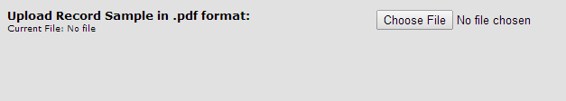

Uploads
Records Sample Upload
Legal Citation Upload
The sample should be representative of the record series.
Be sure to redact any protected information that may be in the sample.
Any statute covering:
  Retention
  Confidentiality
If the record series is governed by multiple citations, please combine them into a single PDF and attached in the application.

Slide 32
Electronic Records Plan Inventory
System Name
IT- ABC Number
Hardware Description
Software Description
System Location
Backup Procedures
Disaster Recovery
Data Migration Description
Metadata Description
If the records are maintained electronically, this section must be fully completed. It is recommended that you get the information for this entire section of the RDA from someone in the agency’s IT office. The entire Electronic Records Plan Inventory must be completed

Slide 33
What Happens Now?
After the RDA is completed and submitted it will go through a review process.
It will be reviewed by the Records Management Division, TSLA, and Audit.
Once reviewed the agency may respond to any recommendations.
The completed RDA then goes before the PRC.
Once the PRC approves the RDA will then become effective.

Slide 34
Why do you need all of this Information?
Although the RDA asks for a significant amount of information about the record series, the PRC nevertheless requires that the information be provided on the RDA.
This process is, ultimately, required by law and this effort flows from the PRC’s resolution to ensure our state is complying with Tenn. Code Ann. § 10-7-303 (d) and § 10-7-509 (a).

Slide 35
Remember…
Records are not to be destroyed without an RDA according to T.C.A. § 10-7-303
  Destruction Procedures. No record or records shall be scheduled for destruction without the unanimous approval of the voting members of the Public Records Commission. Approval for the destruction scheduling from the Commission is received through the RDA process. All agencies shall destroy records using state approved procedures.
Records Management is available to assist you by advising on the development, utilization, retention, disposition, and destruction of records.
If you have any questions please contact me at:
  615-253-4572, or;
  Jasmine.sourignavong@tn.gov

